Slide 1
Windows & Kubernetes
Srinivasan S Iyer

Slide 2

Windows and Kubernetes ecosystem
Currently, Windows machines can only join the cluster as nodes. There is no possibility and no plans for running master components on Windows.
Clusters that run both Linux and Windows nodes are known as being hybrid or heterogeneous.
You will need the latest stable version of Kubernetes and the latest (or almost latest) version of the Windows Server operating system to enjoy the full support that's on offer.
For example, for Kubernetes 1.17, you need Windows Server 1809
(Semi-Annual Channel release) or Windows Server 2019 (the same release but coming from the Long-Term Servicing Channel), lthough the latest Windows Server, 1903, is also supported.

Slide 3
Kubernetes Limitations on Windows
Windows machines can only join the cluster as worker nodes. There is no possibility and no plans for running master components on Windows.
Windows Server 1809 or 2019 is the minimal requirement for the OS on worker nodes.
You cannot use Windows 10 machines as nodes.
Docker Enterprise Edition (Basic) 18.09 or later is required as the container runtime. Enterprise Edition is available at no extra cost for the Windows Server operating system.
The Windows Server operating system is subject to licensing

Slide 4
Kubernetes Limitations on Windows
Hyper-V isolation for Windows Server containers running on Kubernetes is in its experimental phase (alpha) and the current design will be deprecated in favor of the containerd implementation of the runtime.
Until that time comes, the compatibility rules for process-isolated containers apply – you have to run
containers with a base OS image that matches the host OS version
Linux Containers on Windows (LCOW) is not supported.

Slide 5
Kubernetes Limitations on Windows
Hyper-V isolation for Windows Server containers running on Kubernetes is in its experimental phase (alpha) and the current design will be deprecated in favor of the containerd implementation of the runtime.
Until that time comes, the compatibility rules for process-isolated containers apply – you have to run
containers with a base OS image that matches the host OS version
Linux Containers on Windows (LCOW) is not supported.
The Windows nodes join process is not automated as much as it is for Linux
nodes

Slide 6
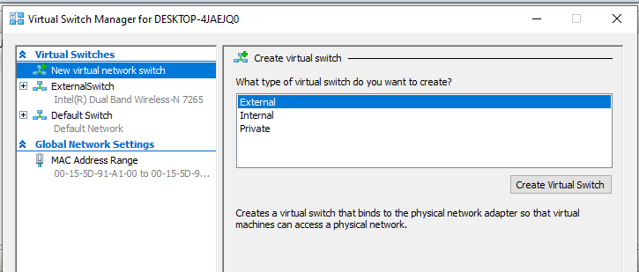
Installing Minikube – Create a Virtual Switch in Hyper-V

